Slide 1
Relative Pronouns in English: Usage and Useful Examples

Slide 2
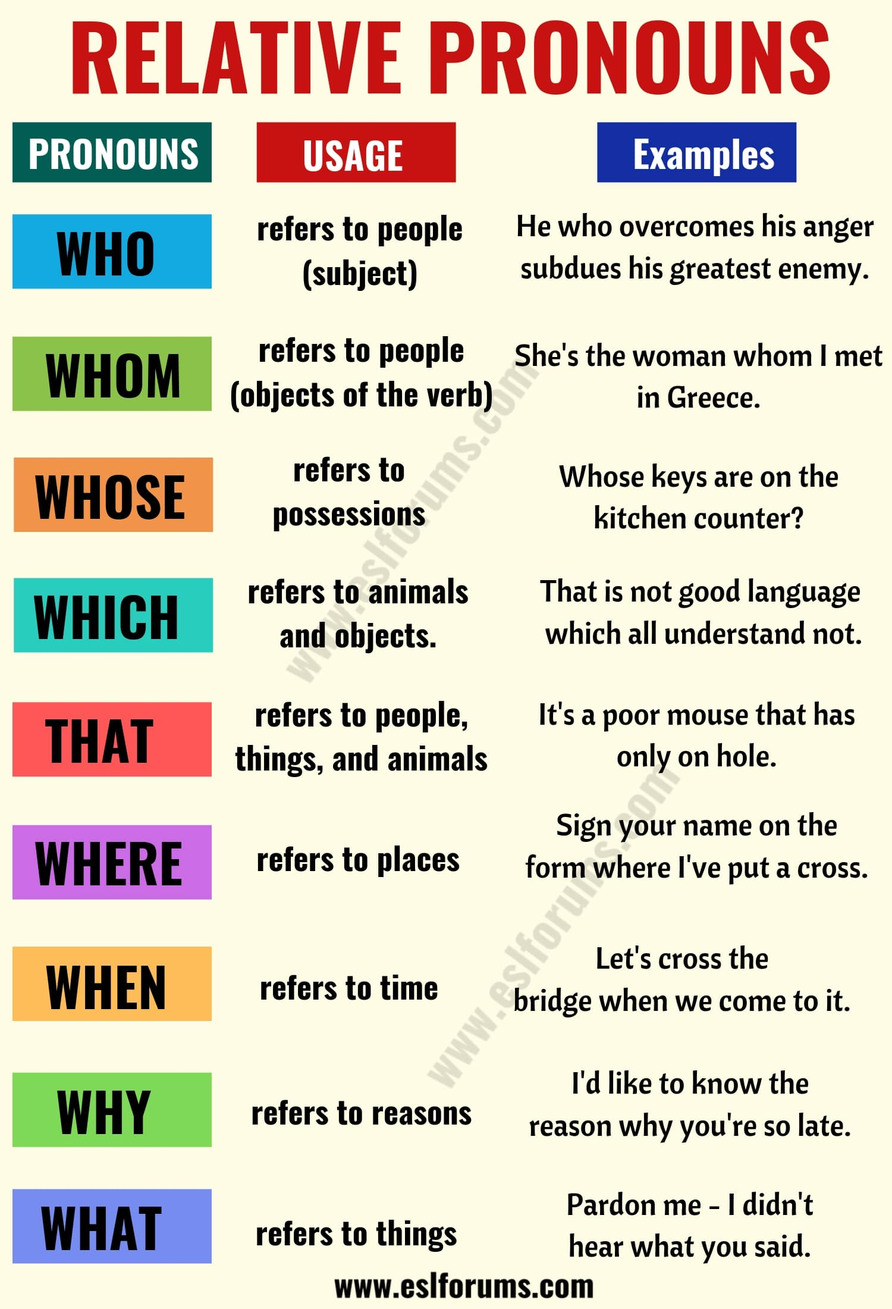

Slide 3
WHAT IS A RELATIVE PRONOUN?
A relative pronoun functions as a word that links two clauses into a single complex clause. It is similar in function to a subordinating conjunction. Unlike a conjunction, however, a relative pronoun stands in place of a noun.
In English, relative pronouns are who, whom, which, that, where, whose, when, why, what.
LIST OF RELATIVE PRONOUNS
Learn relative pronouns with their usages and examples.
WHICH
“Which” refers to animals and objects.
Can act as the subject or the object of the relative clause
Examples:
The wisdom of nations lies in their proverbs, which are brief and pithy.
Laws are like cobwebs, which may catches small flies, but let wasps and horns break through.
Never leave that until tomorrow which you can do today.
He was unwilling to make a prediction about which books would sell in the coming year.

Slide 4
THAT
“That” refers to people, things, and animals (who and which can be replaced by that, which we use commonly in spoken English)
Can act as the subject or the object of the relative clause
Examples:
It’s a poor mouse that has only on hole.
The love that is too violent will not last long.
It is a good horse that never stumbles; and a good wife that never grumbles.
Think about the misforture of others that you may be satisfied with your own lot.
WHO
“Who” refers to people. Can act as the subject or the object of the relative clause
Examples:
He who overcomes his anger subdues his greatest enemy.
I don’t know who my grandfather was. I’ m much more concerned to know what his grandson will be.
He who is ashamed of asking is ashamed of learning.
The man who makes no mistakes does not usually make anything.

Slide 5
WHOM
“Whom” refers to person when the person is the object of the verb
Examples
She’s the woman whom I met in Greece.
From whom did you receive these flowers?
They demanded a huge ransom for the return of the little girl whom they had kidnapped.
The author whom you criticized in your review has written a reply.
WHOSE
“Whose” refers to possessions of people, animals
Examples:
Whose keys are on the kitchen counter?
Choose a stylist recommended by someone whose hair you like.
She’s the student whose handwriting is the best in my class.
I felt great pity for the woman whose baby died.

Slide 6
WHERE
“Where” refers to places
Examples:
The moon is not seen where the sun shines.
Love will creep where it may not go.
Sign your name on the form where I’ve put a cross.
My leg is still very tender where it was bruised.
With a nod of his head he indicated to me where I should sit.
WHEN
“When” refers to time
Examples:
He is wise that knows when he’s well enough.
The highest possible stage in moral culture is when we recognize that we ought to control our thoughts.
The wolf has a winning game when the shepherds quarrel.
Let’s cross the bridge when we come to it.

Slide 7
WHY
“Why” refers to reasons
Examples:
She cited three reasons why people get into debt.
Everyone was curious as to why Mark was leaving.
I think you’d better tell us why you’re asking these questions.
I’d like to know the reason why you’re so late.
WHAT
“That” refers to things
Examples
Don’t put off what you can do today till tomorrow.
Never trust another what you should do yourself.
It is no use doing what you like ; you have got to like what you do.
Pardon me – I didn’t hear what you said.

