Slide 1
Personal Pronouns
Subject Pronouns
And
Possessive Pronouns

Slide 3
There’re two types of personal pronouns: Subject pronouns and object pronouns
We use personal pronouns when the person or thing is the subject of the sentence. For examples:
I love cooking but she does not.
We use object pronouns when the person or thing is the object of the sentence.
Peter likes her, not me.
PERSONAL PRONOUNS WITH EXAMPLES
I have five brothers and one sister.
If you wish to learn English, you must study.
He has a big brown cat.
Mrs. Klassen is a great teacher; she makes learning fun.
It is snowing today.
We learned adjectives in class yesterday.
They don’t know how to swim.

Slide 4
Please, don’t be rude to me.
I know him since he was a little boy.
Maria told me that I must go with her.
I invited them to dinner, they will arrive soon.
We decided to take my dog with us when we go on vacation.
We know not what is good until we have lost it.
Pay online and the merchandise will be mail to you.

Slide 5
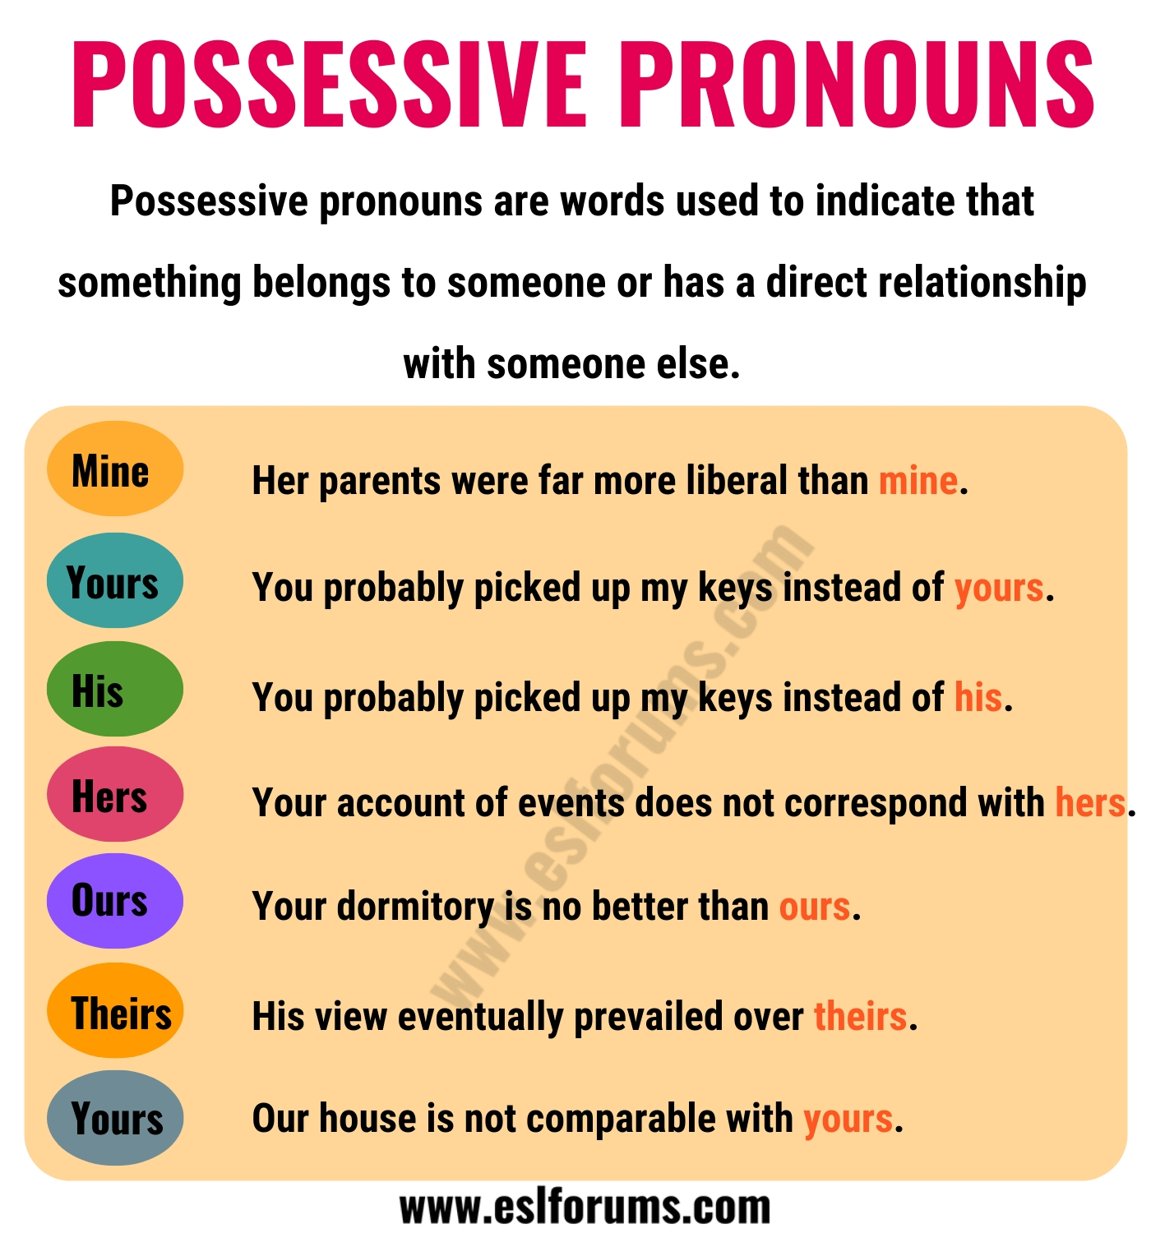

Slide 6
Examples with possessive pronoun – Mine:
This car is mine.
His ideas do not square with mine.
Her right hand is inches from mine.
Her parents were far more understanding than mine.
Hi, Joe. I’d like you to meet a friend of mine.
Sending you a kiss to say I’m glad that you are mine. Happy Valentine’s day!
Carlos has a bigger car than mine.
He is not a friend of mine, only an acquaintance.
Examples with possessive pronoun – Yours:
You roll my log and I’ll roll yours.
Is she a friend of yours?
Is Bob an old friend of yours?
Wishing you and yours a happy new year.
You probably picked up my keys instead of yours.
Our house is not comparable with yours.
She just bought a new car just like yours.

Slide 7
Examples with possessive pronoun – His:
This is my brother’s book. It’s his.
Is she a friend of his?
You probably picked up my keys instead of his.
This is our room, and his is just across the hall.
Examples with possessive pronoun – Hers:
That skirt of hers is very colerful.
I mixed my color pencils with hers.
Your class schedule is just like hers.
Your uniform don’t match with hers.
He placed his hand over hers and looked into her eyes.

Slide 8
Examples with possessive pronoun – Ours:
It is interesting to compare their situation and ours.
He lived in a nicer house than ours.
Your dormitory is no better than ours.
She became a lifelong friend of ours.
The fire destroyed everything that was ours.
We were left with the impression that the contract was ours if we wanted it.
Examples with possessive pronoun – Theirs:
How can we match our generosity against theirs?
Our problems are insignificance when compared to theirs.
His view eventually prevailed over theirs.
They looked at our pictures, but they didn’t show us theirs.
When our washing machine broke, our neighbors let us use theirs.
We’ve kept our end of the deal – let’s see if they keep theirs.
Other marriages might go stale , but not theirs.
We built a new house up against theirs.

